Slide 1
The role of fundamental science in the new era of AI
01.07.25 @ NKNU

Slide 2
A quick survey…
Which of the following is a better model of the world?
A simple model that we can “understand”, and it predicts 90% of the events correctly
A complex model that forms a “black box”, but predicts 99% of the events correctly

Slide 3
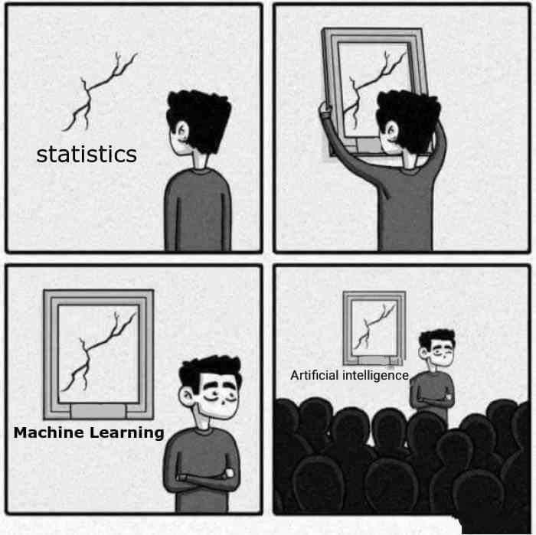
What do we mean by AI?
AI: Exhibiting “intelligence” in computing machines
Traditionally, AI has been approached in various ways, including logic, symbolic reasoning, and rule-based expert systems
In recent years, we mostly focus on the “machine learning” approach

Slide 4
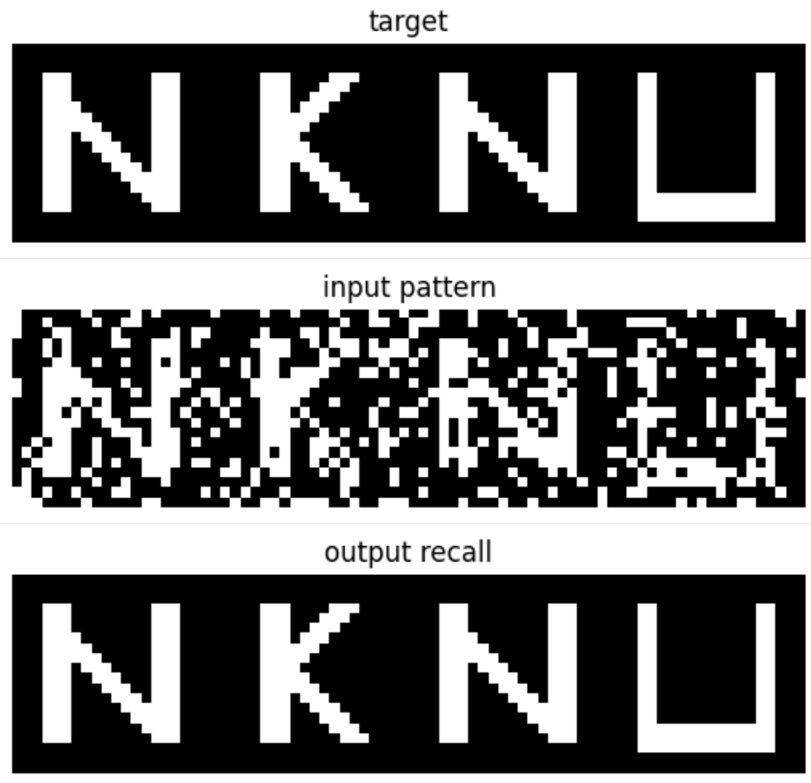
Machine learning (ML) — what do we mean by “learning”?
Target: y = 3
Input: x = 1.5
Model: y = xθ
Learn the parameter: θ
Optimize for the solution:
θ=3 ❌
θ=2 ✅
θ=1 ❌

Slide 5
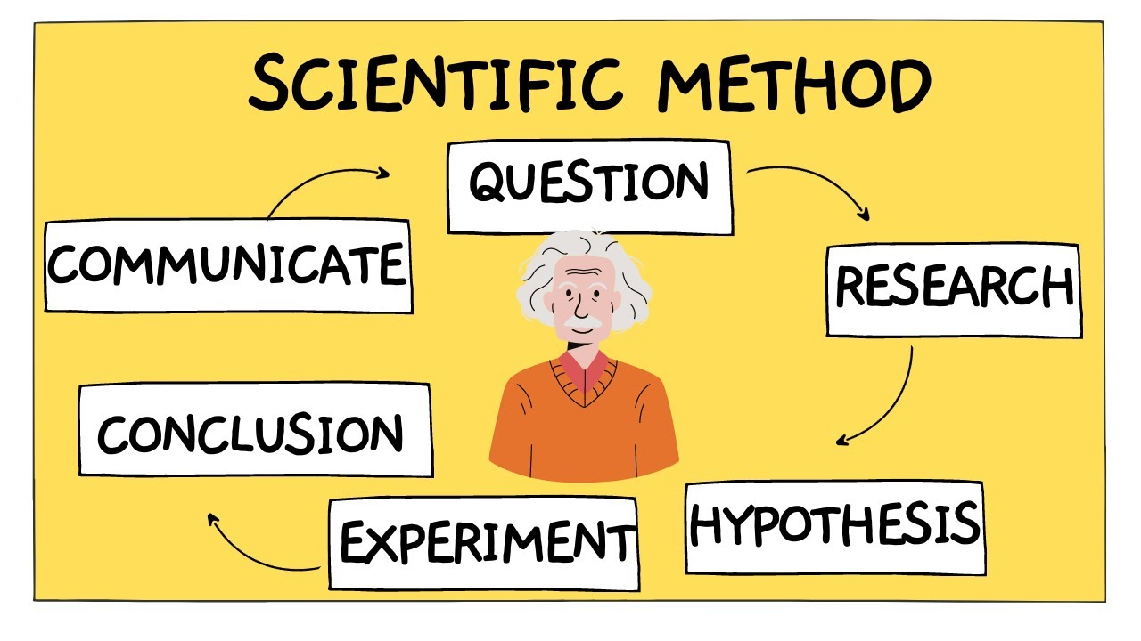
What is science, if one may ask?
“In science, if you know what you are doing, you should not be doing it.
In engineering, if you do not know what you are doing, you should not be doing it.”
– R. Hamming (1915-1998)
When would AI come into play?
Does AI follow the scientific method?

Slide 6
Outline
What is AI – it is not science
Empowering scientific research with AI tools
AI is science – it thrives on science, past and future
Studying AI with a scientific perspective
Concluding remarks

Slide 7
Outline
What is ML – it is not science
Empowering scientific research with ML tools
ML is science – it thrives on science, past and future
Studying ML with a scientific perspective
Concluding remarks

Slide 8
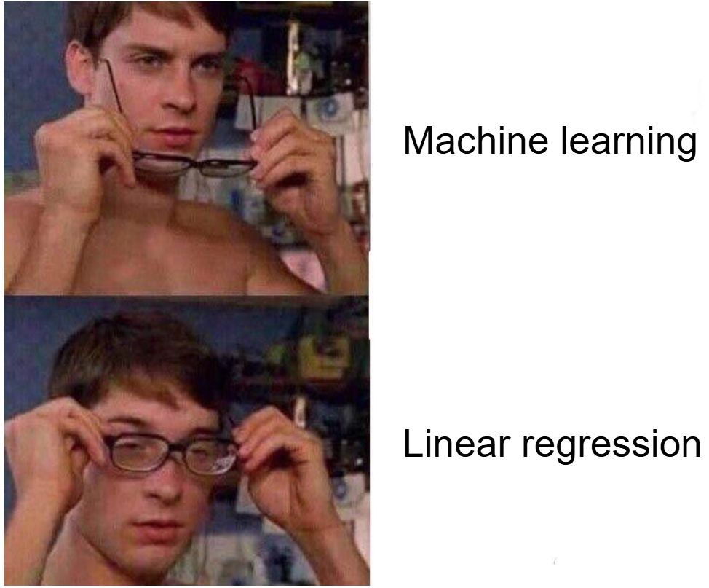
Machine learning (ML) 101
data (x) → ‘model’ (f) → learning (update θ with respect to L) → prediction (y)
Give me abstract level
Making prediction
Defining the objective to optimize
Learning the parameters
Give me concrete example
Linear model
Penalized mean square error
Analytically solve for solution

Slide 9
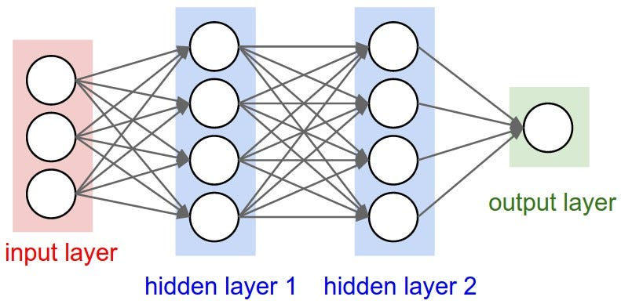
ML 102 – case study to go deeper
data (x) → ‘model’ (F) → learning (update θ with respect to L) → prediction (y)
Schematics of deep network
Specifics of deep network
Activation of hidden units
Defining the objective to optimize
Learning the parameters

Slide 10
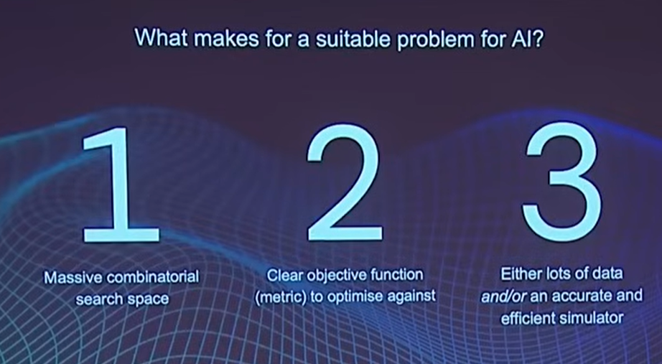
Recipe of “success”
data (x) → ‘model’ (F) → learning (update θ with respect to L) → prediction (y)
data (x)
model (F)
prediction (y)
parameters (θ)
objective (L)
prediction (y)
data (x)
model (F)
Ilya Sutskever’s keynote speech at NeurIPs 2024
(co-founder and chief scientist at OpenAI)
Demis Hassabis’s Nobel lecture 2024

Slide 11
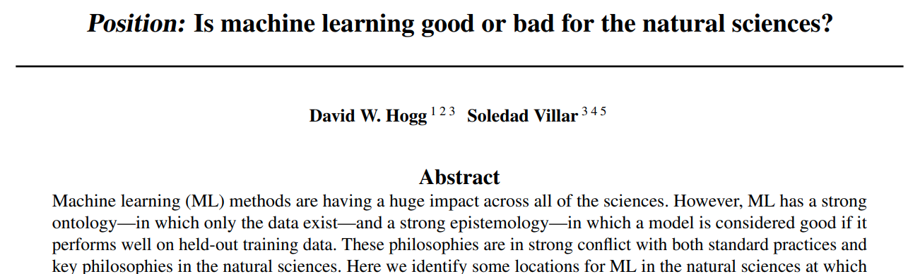
ML challenges scientific research, in some sense
…
 | Machine learning | Natural science
What “exists”? | Data | Latent structure
What is “success”? | Accurate model | Understanding

Slide 12
Would science be left out if not joining? An existential crisis?
Yes and No
No to the latter question
ML itself, at the current stage, does not necessarily provide new scientific insights
Yes to the former question
ML serves as a powerful new technique that can help/correct scientific progress
“Progress in science depends on new techniques, new discoveries and new ideas, probably in that order.”
– Sydney Brenner (1927-2019)

Slide 13
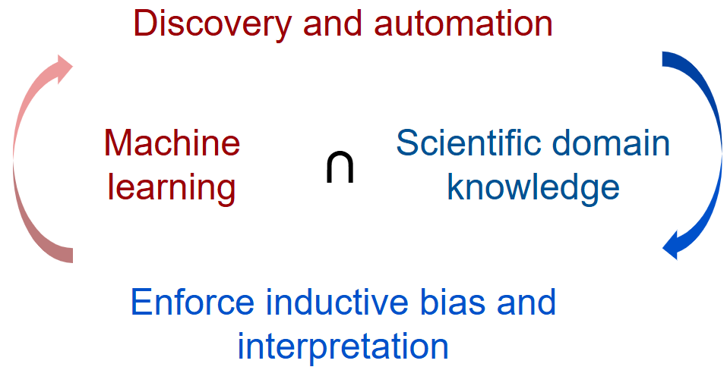
ML application to scientific research
Applying ML as an automation tool
Enforcing scientifically interpretable ML

Slide 14
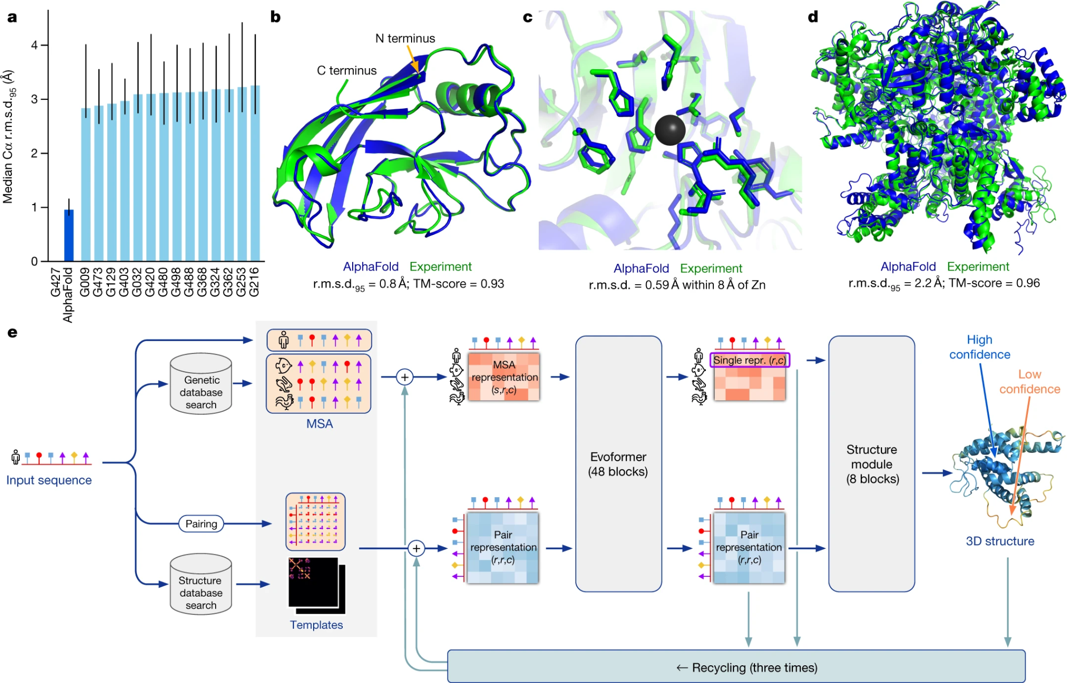
Application case 1: Alphafold
Data: protein database (PDB)
Model: “evoformer”, an attention-based neural network
Objective: predict protein structure given the sequence
Jumper, John, et al. "Highly accurate protein structure prediction with AlphaFold." nature 596.7873 (2021): 583-589.

Slide 15
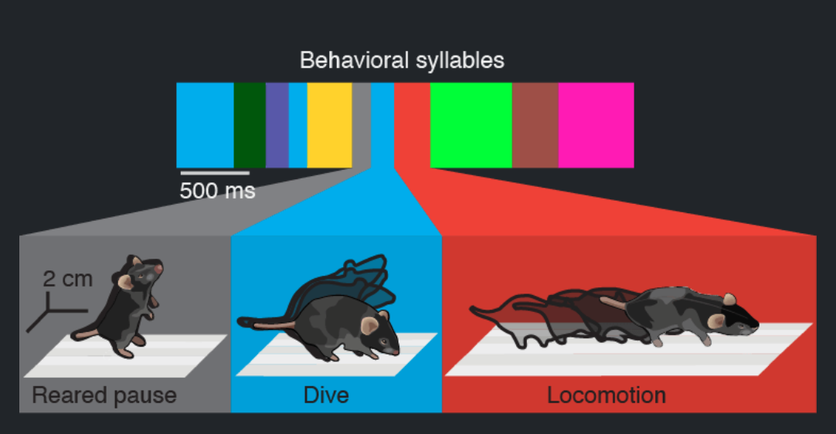
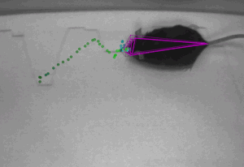
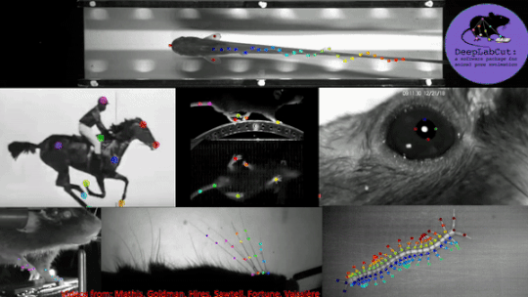
Application case 2: Behavioral tracking
Data: labeled animal postures
Model: convolution neural network (ResNet)
Objective: reliable tracking of posture that agree with human labels
Mathis, A, et al. "DeepLabCut: markerless pose estimation of user-defined body parts with deep learning." Nature neuro. 2018

Slide 16
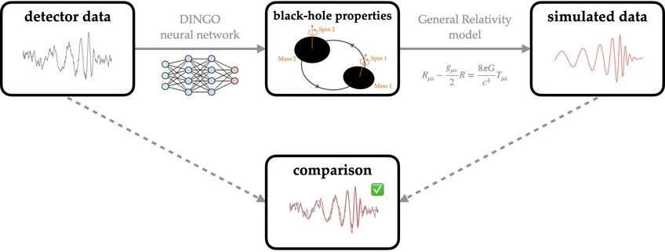
Application case 3: Black hole reconstruction
Data: top: very long baseline interferometer (VLBI); bottom: Laser Interferometer Gravitational-Wave Observatory (LIGO)
Model: top: dictionary learning; bottom: neural posterior estimation
Objective: more robust, interpretable posterior inference
Medeiros, Lia, et al. "The image of the M87 black hole reconstructed with PRIMO." The Astrophysical Journal Letters. (2023)
Dax, M, et al. "Neural importance sampling for rapid and reliable gravitational-wave inference." Physical Review Letters. (2023)

Slide 17
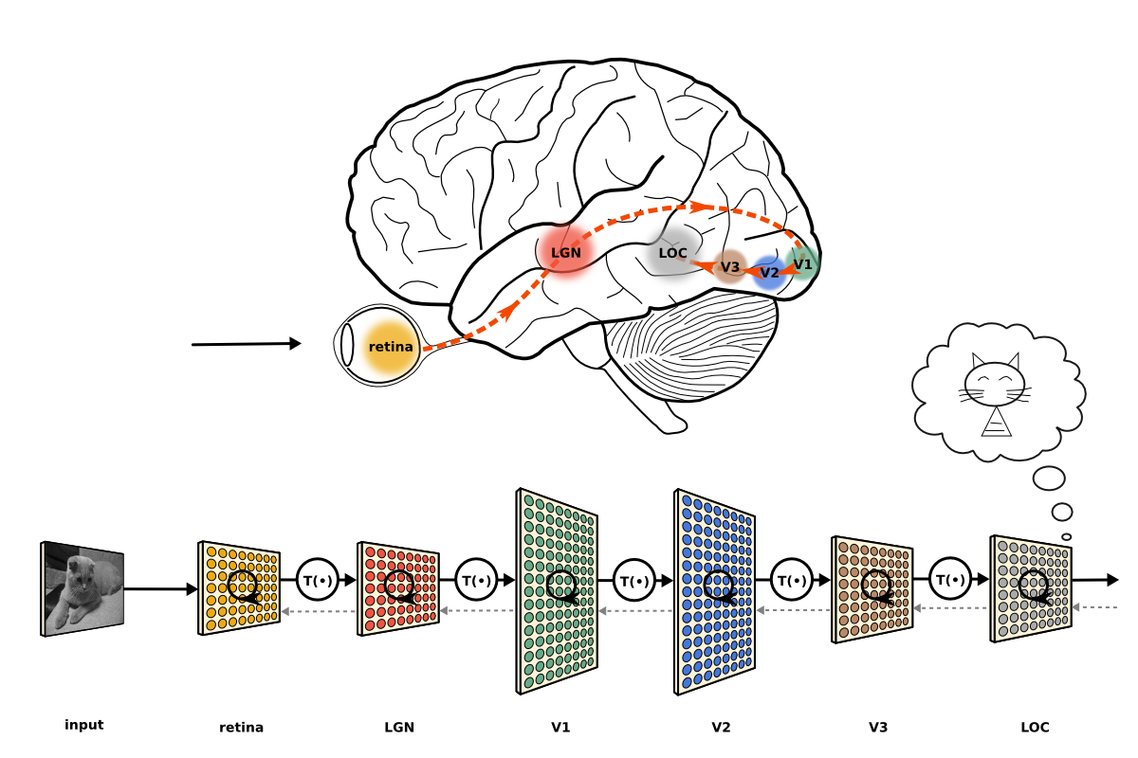
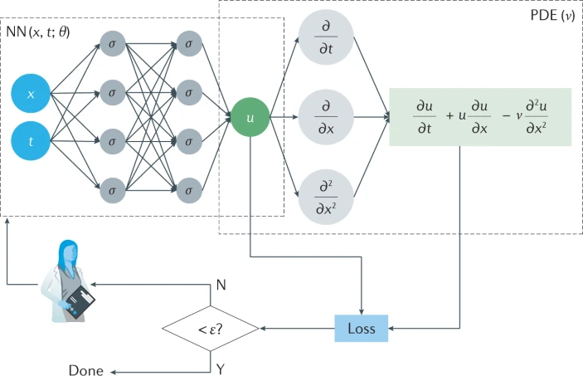
Application case 4: ‘Science-constrained’ models
Comparing artificial nets to biological nets
Physics-informed neural network (PINN)
Yamins, D, et al. "Performance-optimized hierarchical models predict neural responses in higher visual cortex." PNAS. 2014
Karniadakis, G, et al. "Physics-informed machine learning." Nature Reviews Physics 3.6. 2021

Slide 18
Intermediate summary
What is ML – it is not science
Empowering scientific research with ML tools
ML may not be science, but it is a powerful and and indispensable tool for scientific research, particularly when specific criteria are met
Two main types of application: (1) an intelligent way to automate scientific method, (2) an approach to reveal scientific insights

Slide 19
Outline
What is ML – it is not science
Empowering scientific research with ML tools
ML is science – it thrives on science, past and future
Studying ML with a scientific perspective
Concluding remarks

Slide 20
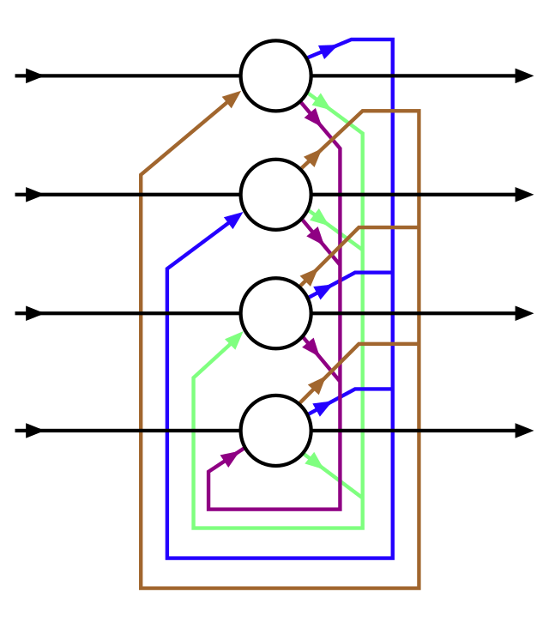
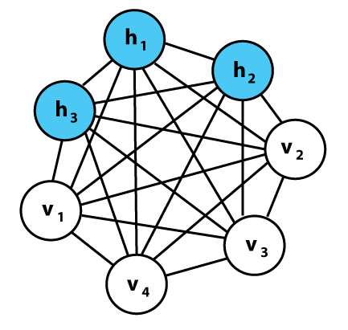
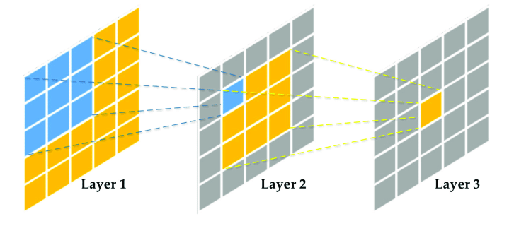
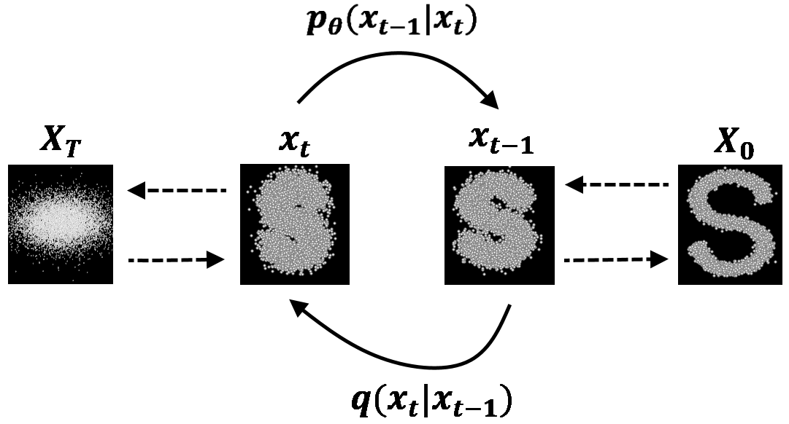
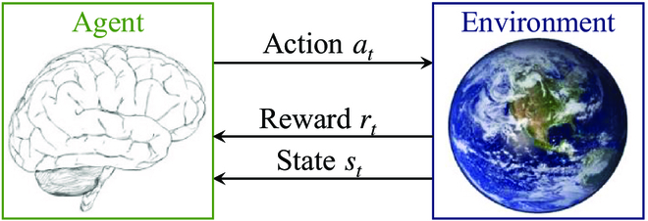
ML is rooted in science
Hopfield model for neural and physical computing system (1982)
The Boltzmann machine for brain learning (1985)
Convolution net from receptive fields in neuroscience (1989)
Diffusion models from nonequilibrium physics (2000s)
Reinforcement learning from cognitive science (1980s)

Slide 21
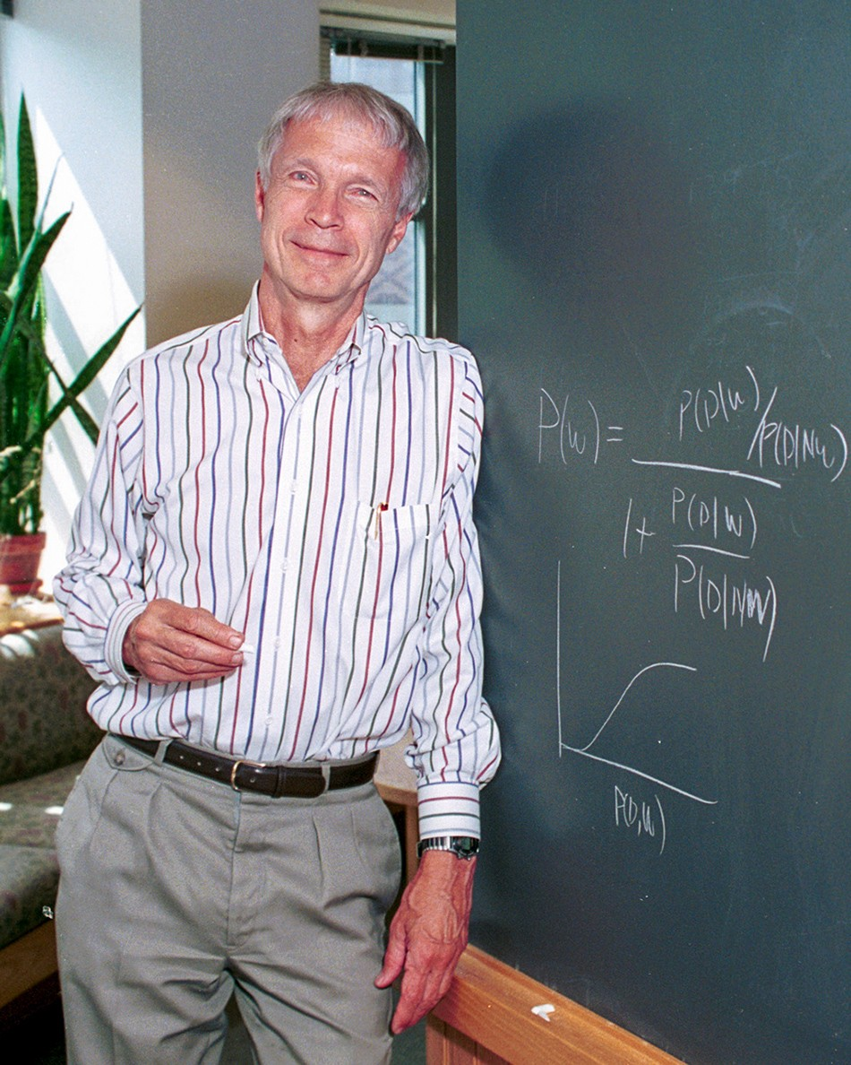
Short divergent for my scientific hero – Hopfield
Bell Labs (1954-1964)
Princeton University (Physics, 1964–1980)
Caltech (Chemistry and Biology, 1980–1997)
Princeton (1997–), Professor of Molecular Biology at Princeton Neuroscience Institute

Slide 22
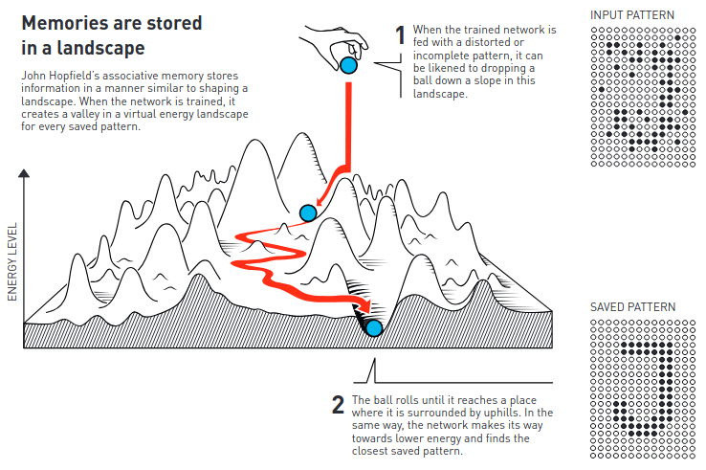
High-level idea of the Hopfield network
Blackboard and demo
Learning rule
Neural dynamics
Energy function

Slide 23
Profound implications of the Hopfield network
“More is different”, in action
There is more to the network then its individual parts (emergence)
Memory is stored in the pattern of connectivity
Computation through dynamics
The concept of a neural state-space
Trajectory and flow are the computation (an “energy landscape” view)

Slide 24
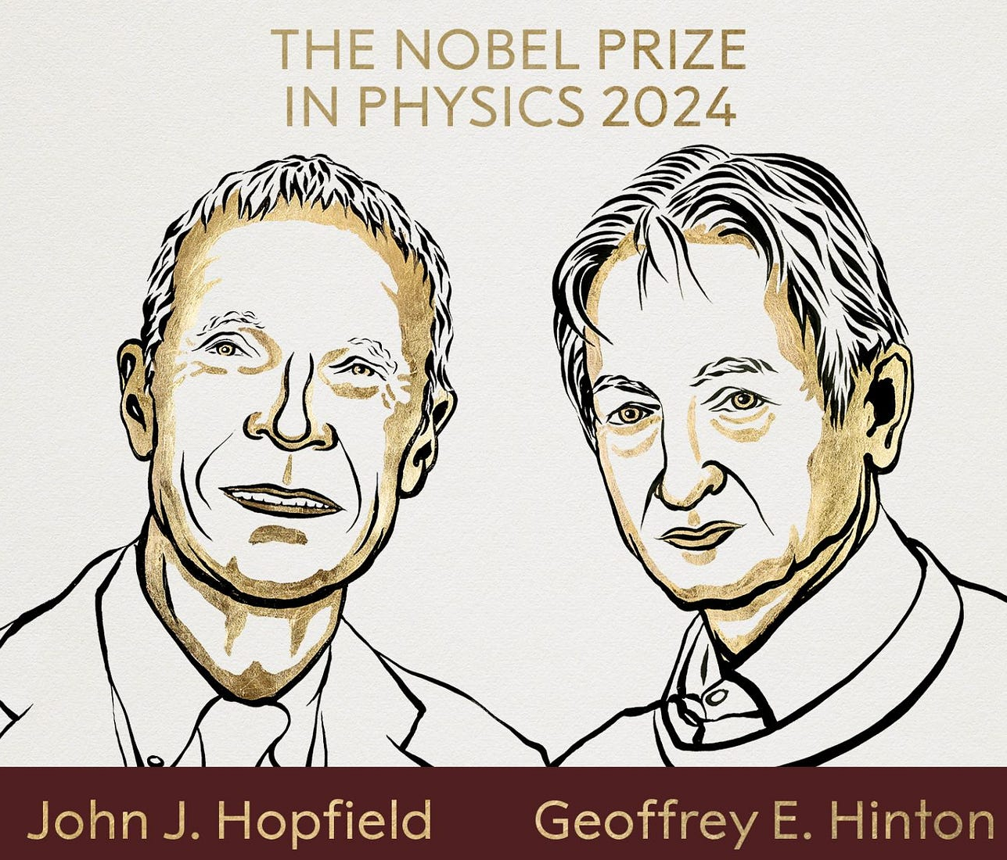
An intricate integration of scientific disciplines
Biology: all-or-none rule of neurons and the synaptic leaning rule
Physics: energy function (Lyapunov function of a dynamical system)
Chemistry: reaction kinetics and Arrhenius law
Extension to modern machine learning…
Hopfield: “The science which advances technology is the science that gets done for curiosity’s sake much earlier”

Slide 25
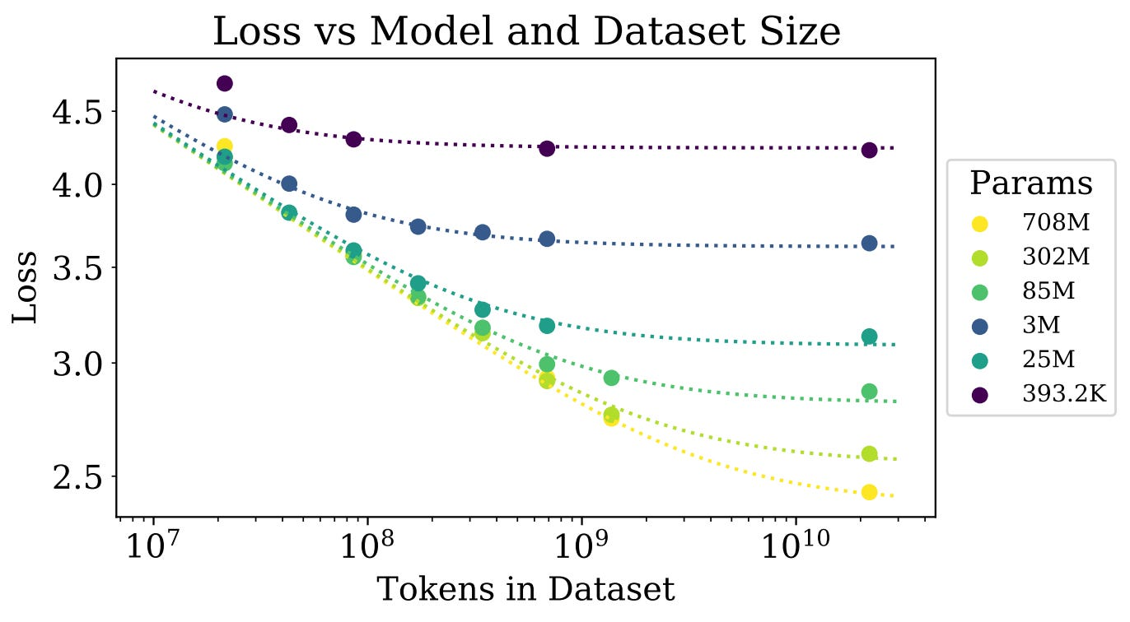
Back to modern machine learning – deep learning
Ilya Sutskever’s keynote speech at NeurIPs 2024
(co-founder and chief scientist at OpenAI)
Kaplan, Jared, et al. "Scaling laws for neural language models." arXiv preprint arXiv:2001.08361 (2020).

Slide 26
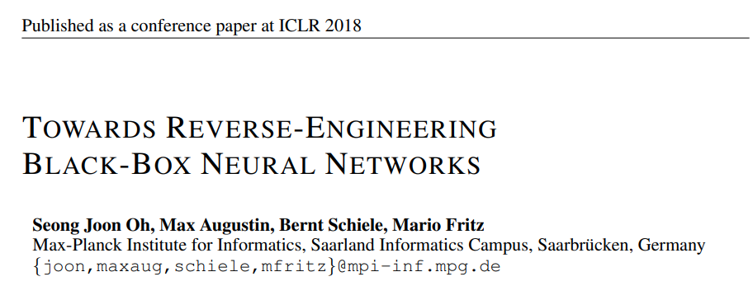
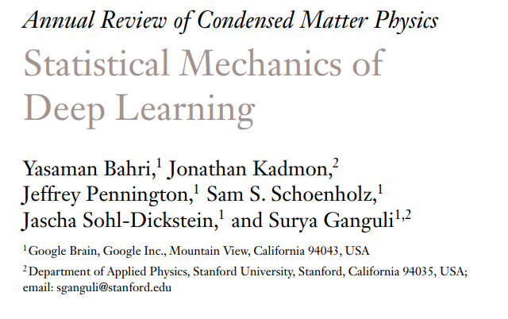
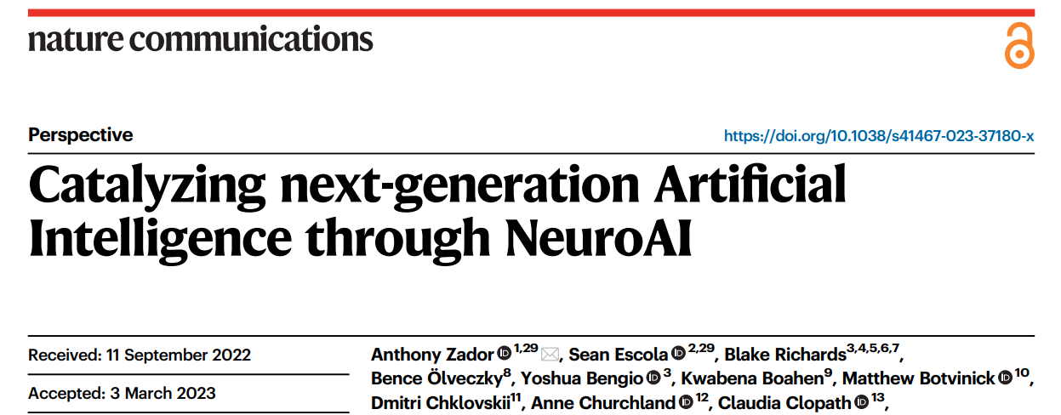
Scientific study of ML
Neural AI initiatives
Reverse engineering approaches
Physical theory of large models
Physical implementation of computation

Slide 27
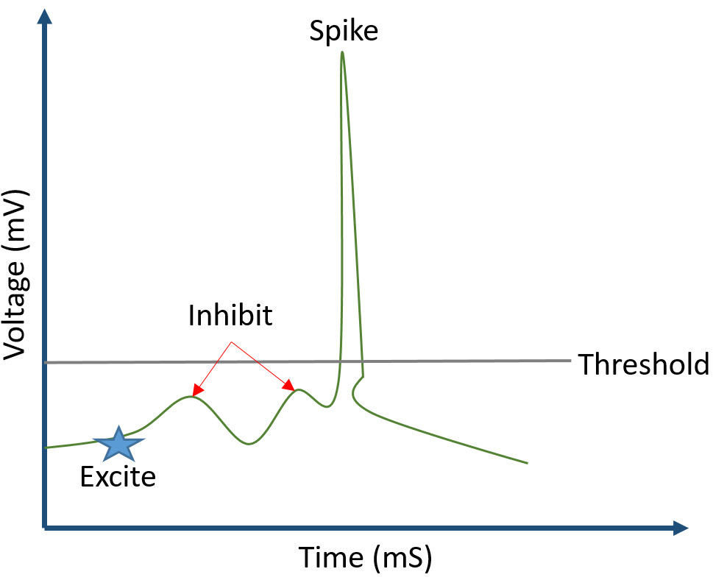
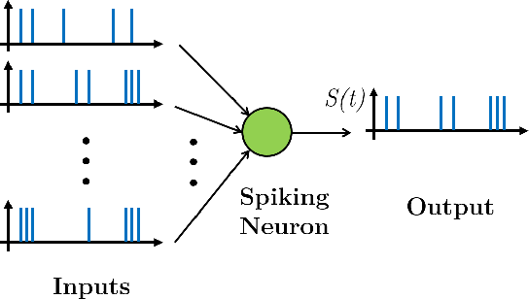
“Neuro-AI”
Manifold learning in neural state-space
Computation with spiking dynamics

Slide 28
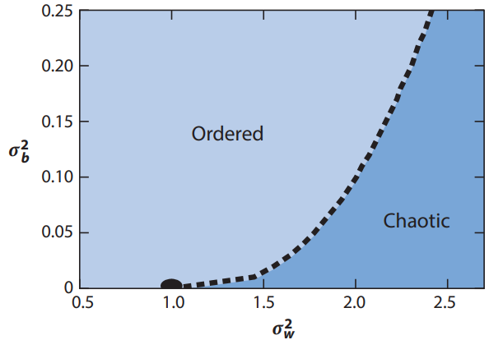
Statistical mechanics of deep learning
Mehta, Pankaj, et al. "A high-bias, low-variance introduction to machine learning for physicists." Physics reports 810 (2019): 1-124.

Slide 29
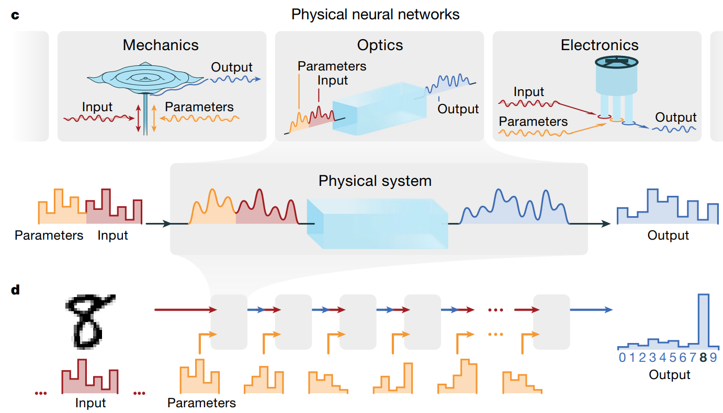
Physical implementation of computation
Other possibilities
The brain!
Soft material
Quantum systems
Wright, Logan G., et al. "Deep physical neural networks trained with backpropagation." Nature 601.7894 (2022): 549-555.

Slide 30
Intermediate summary
ML is science – it thrives on science, past and future
Studying ML with a scientific perspective
ML historically comes from curiosity-driven basic research, and this progress would likely continue
It is important to study the “black box” through scientific methods, whether analytic, empirical, or reverse engineering

Slide 31
Revisiting the question
Which of the following is a better model of the world?
A simple model that we can “understand”, and it predicts 90% of the events correctly
A complex model that forms a “black box”, but predicts 99% of the events correctly

Slide 32
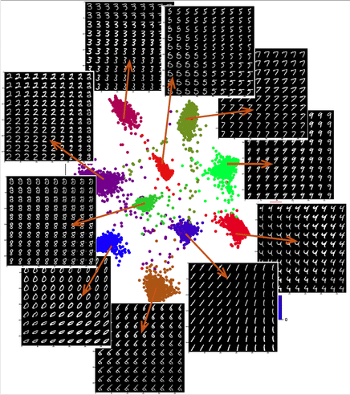
Talk is cheap. Show me the code!
Demonstration of a simple (linear) method
‘Deep’ neural networks
Opening the black box

Slide 33
Outline
What is ML – it is not science
Empowering scientific research with ML tools
ML is science – it thrives on science, past and future
Studying ML with a scientific perspective
Concluding remarks

Slide 34
Concluding remarks
What might be the next frontier of AI?
“Superintelligence”
Agency, interaction with the environment
Robotics: real-world mechanics
Energetics: sustainable and efficient battery
Beyond the frontier…
Education
Fairness
Bias and control
Don’t necessarily chase the waves
The next generation deserves everything

Slide 35
Thank you!
Any questions?

